Slide 1
Support Vector Machines (SVM)
Non Parametric, Binary Classification Technique

Slide 2
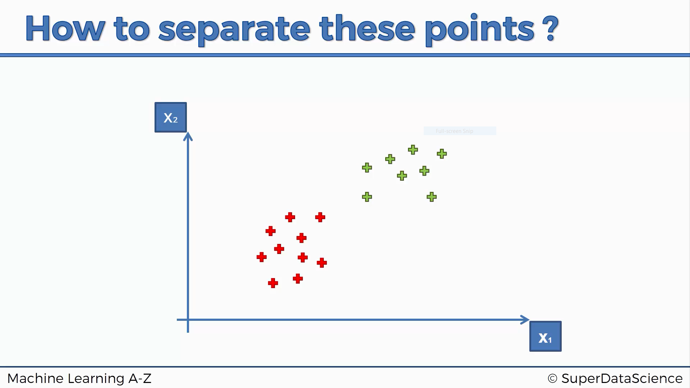

Slide 3
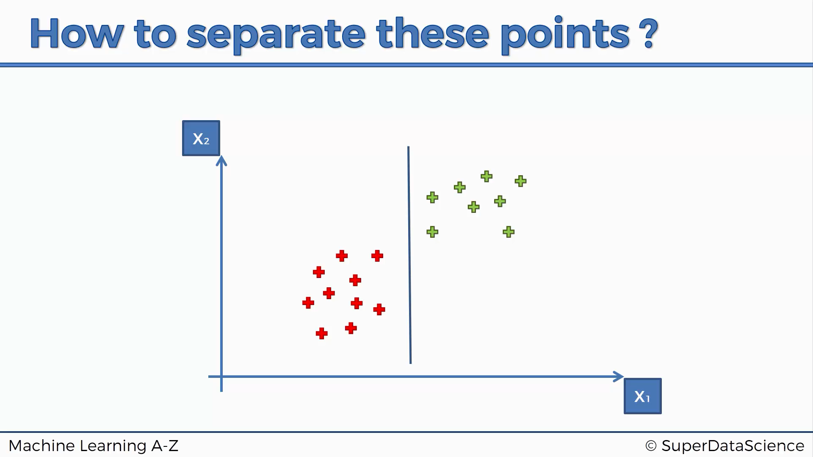

Slide 4
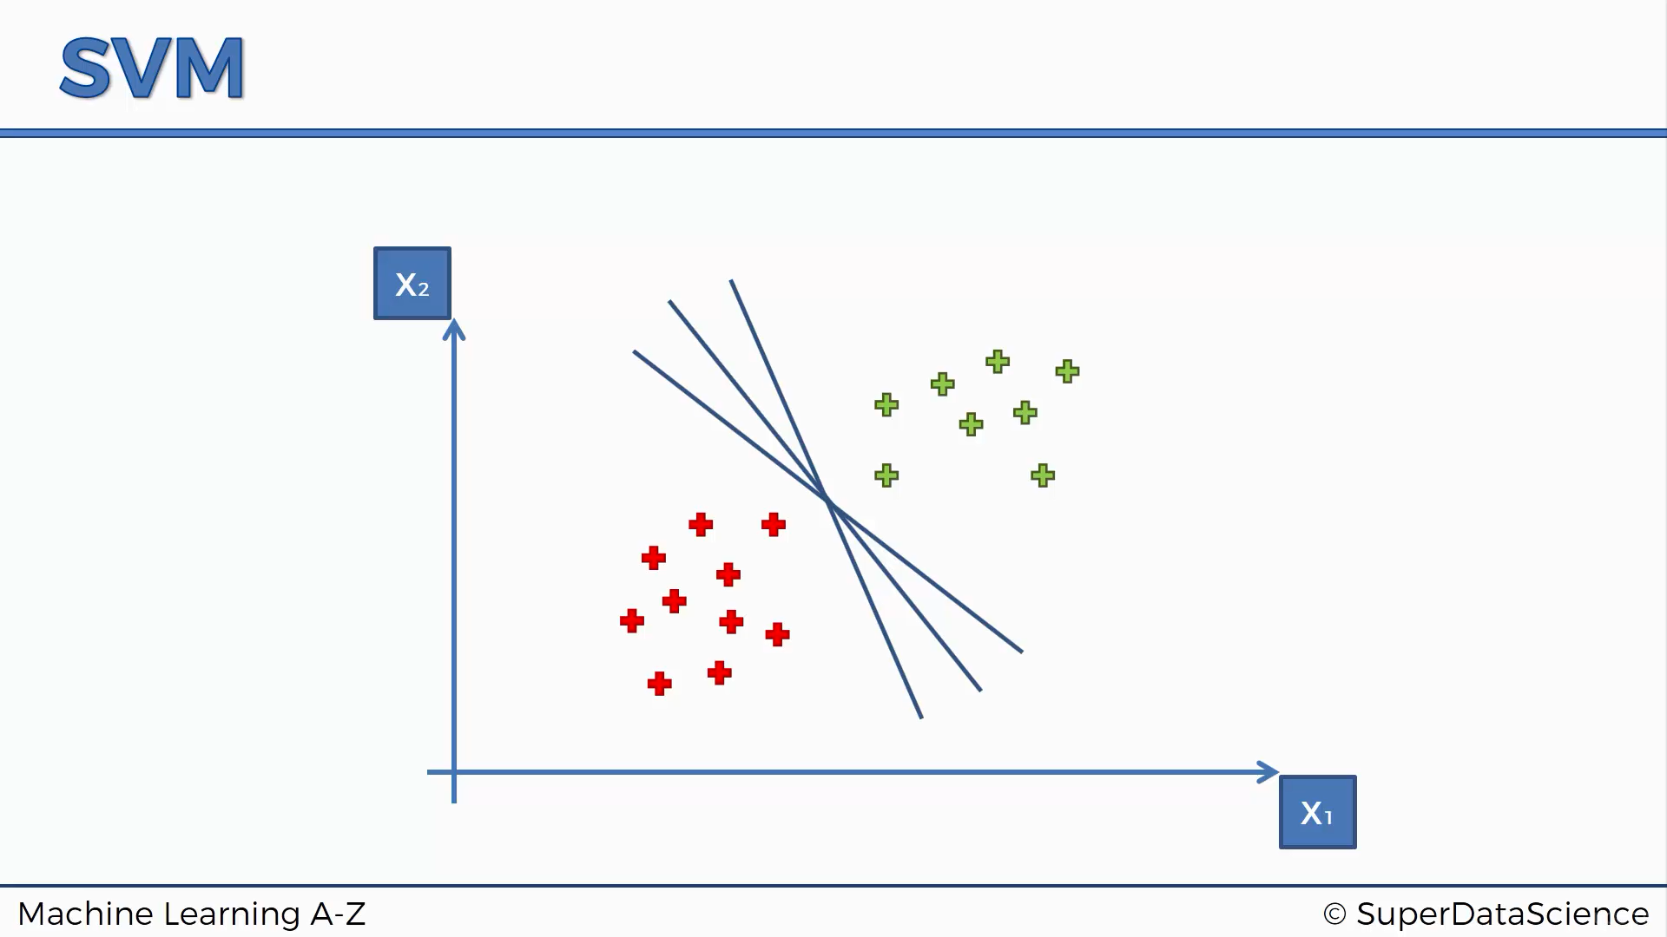

Slide 5
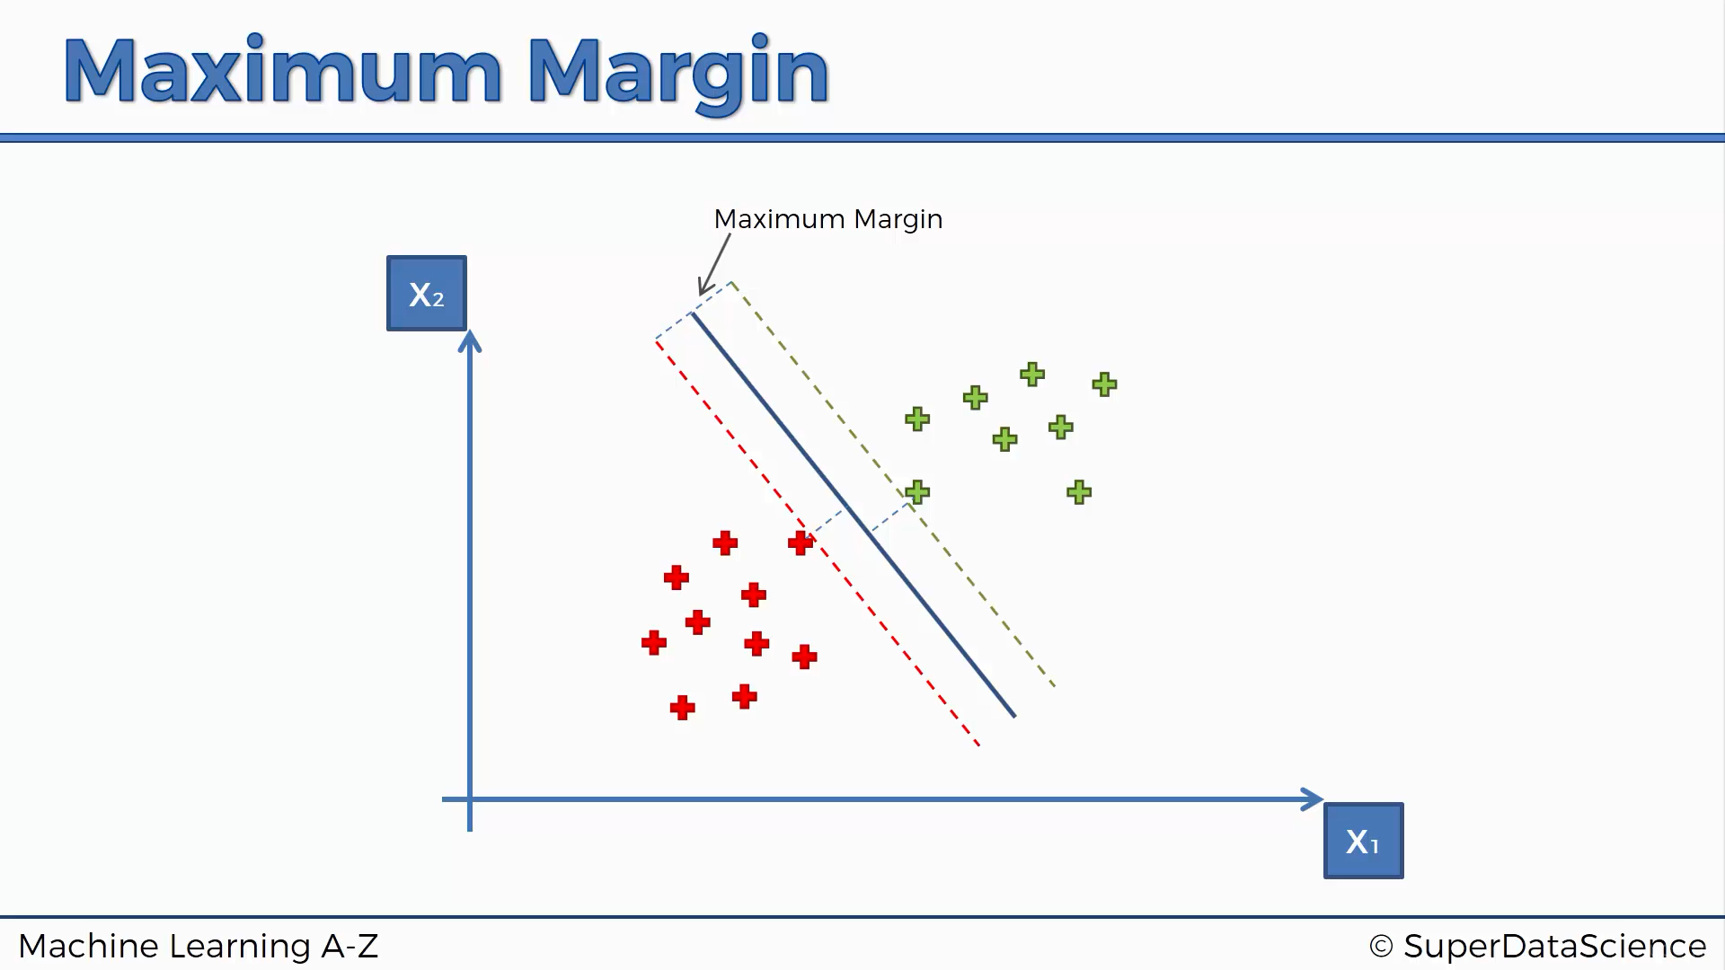

Slide 6
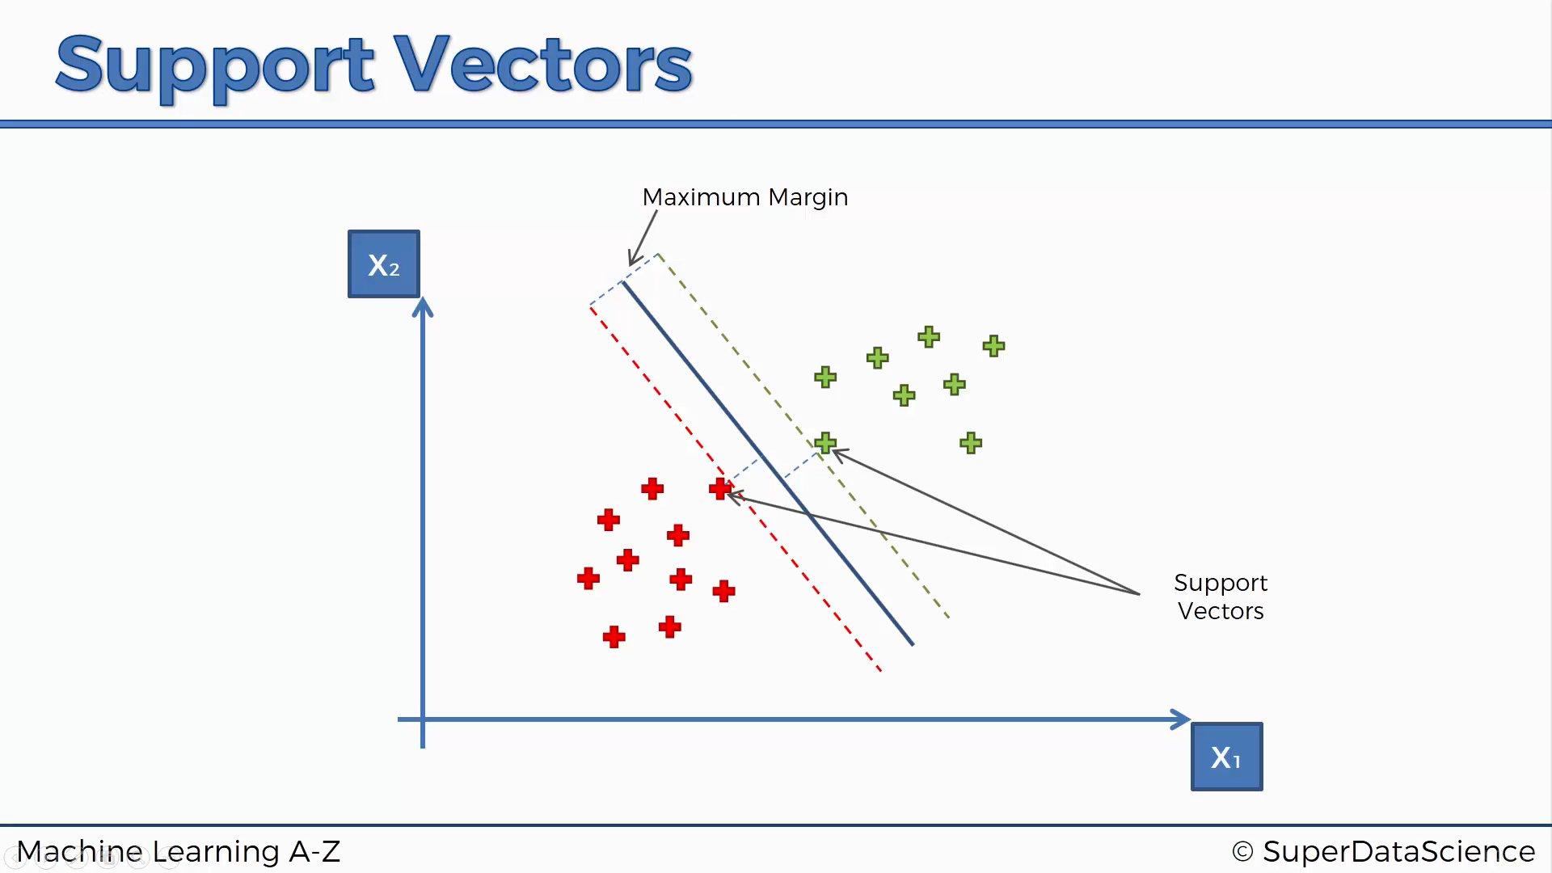

Slide 7
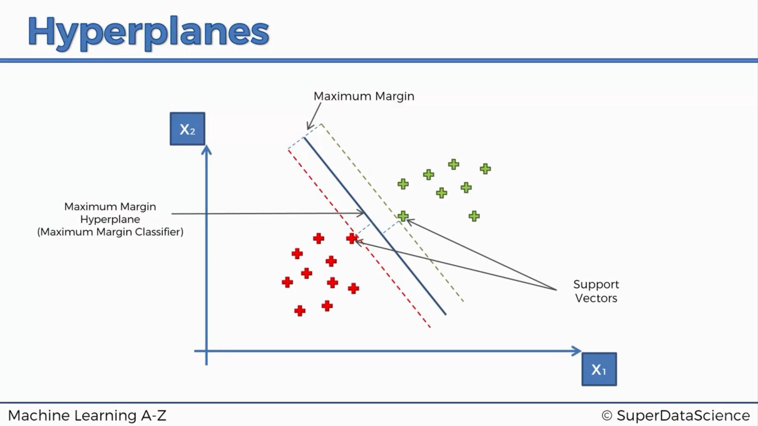

Slide 8


Slide 9
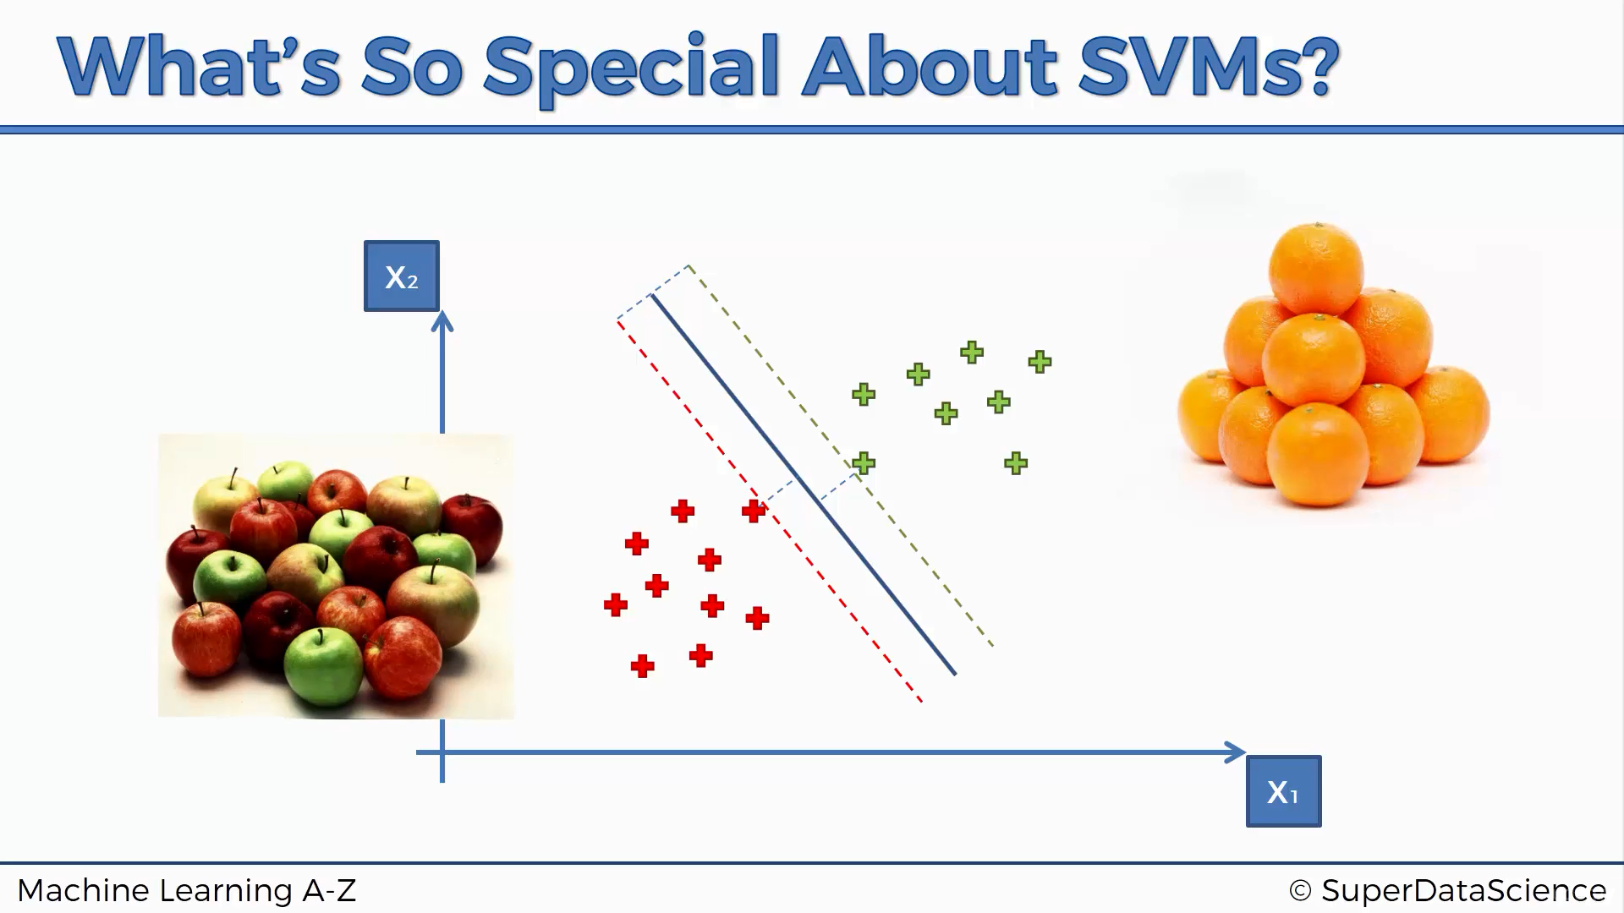


Slide 10
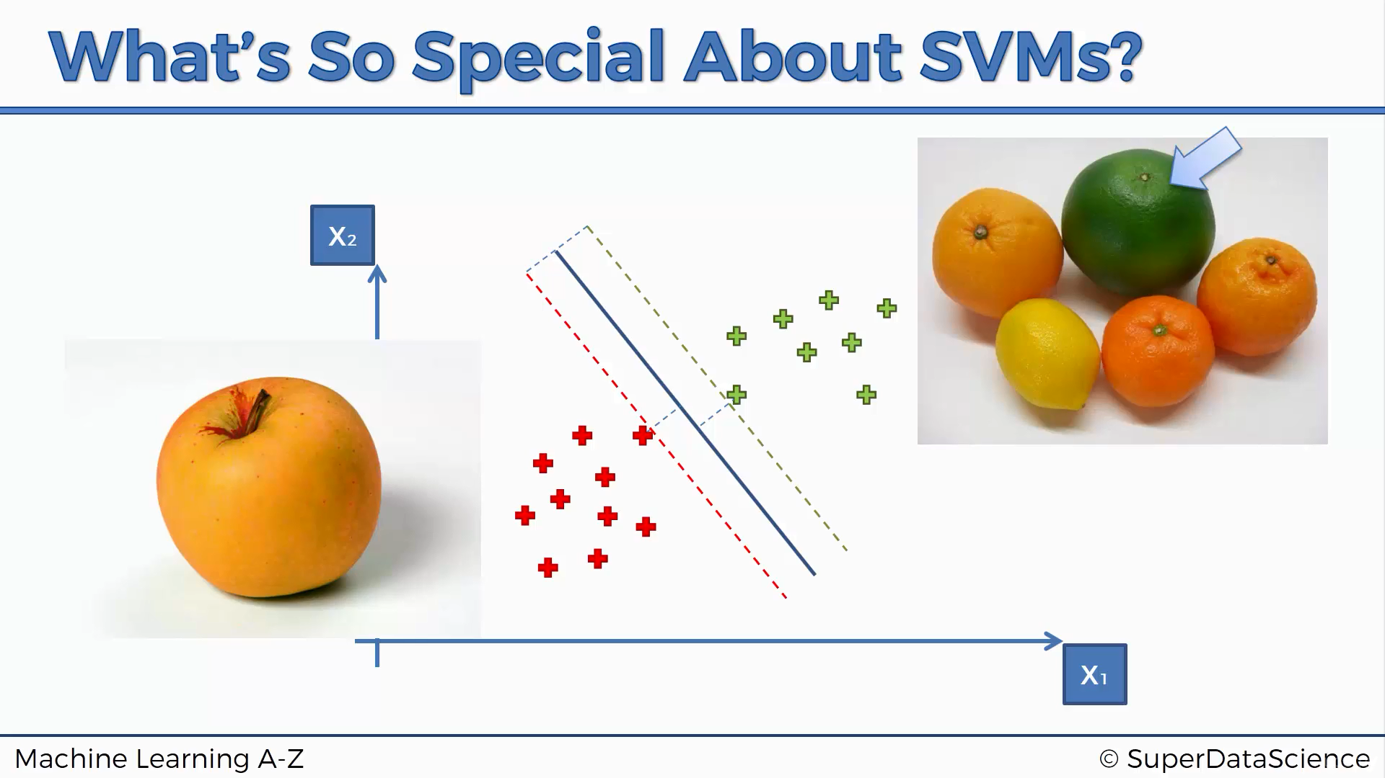
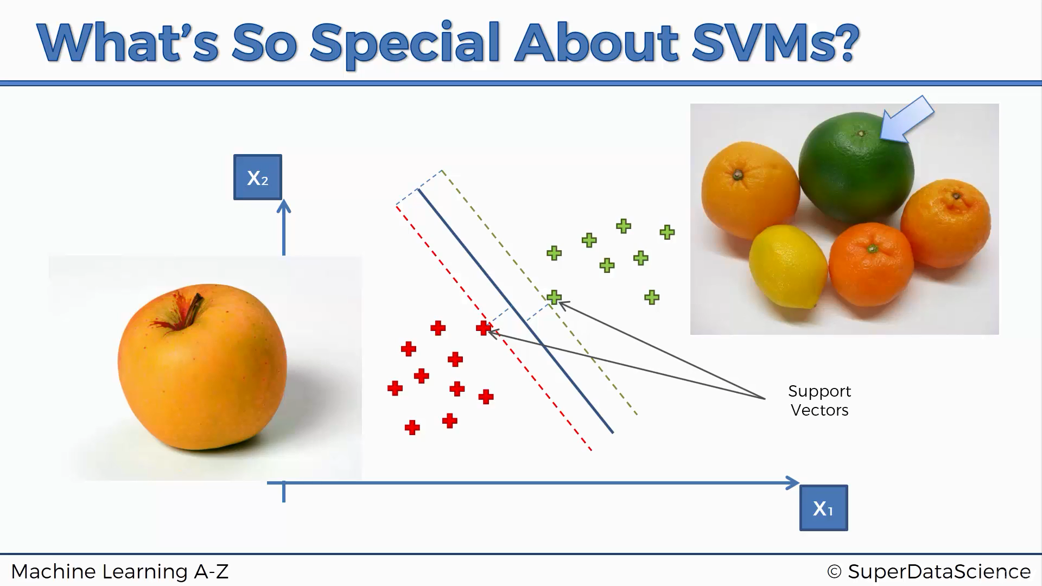

Slide 11
Model Tuning
Tuning SVM Parameters to obtain better results.

Slide 12

Regularization (C Parameter)
The Regularization parameter (often termed as C parameter in python’s sklearn library) tells the SVM optimization how much you want to avoid misclassifying each training example.
For large values of C, the optimization will choose a smaller-margin hyperplane if that hyperplane does a better job of getting all the training points classified correctly.
Conversely, a very small value of C will cause the optimizer to look for a larger-margin separating hyperplane, even if that hyperplane misclassifies more points.

Slide 13
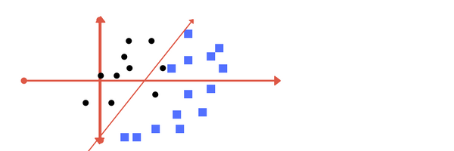
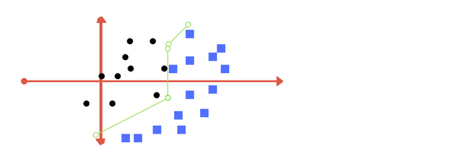
Low Regularization (C) value
Higher Regularization (C) value

Slide 14


Gamma
The gamma parameter defines how far the influence of a single training example reaches, with low values meaning ‘far’ and high values meaning ‘close’.
For lower gamma value, the points far away from plausible separation line are considered in calculation for the separation line.
Higher gamma means the points close to plausible line are considered in calculation.

Slide 15
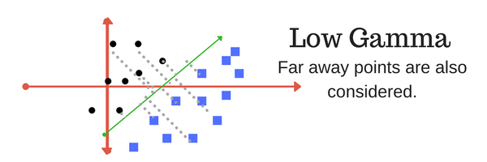
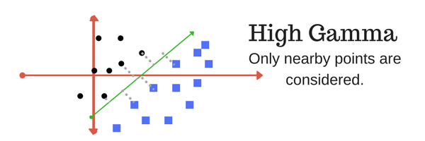

Slide 16
Python’s sklearn Documentation
http://scikit-learn.org/stable/modules/svm.html
http://scikit-learn.org/stable/modules/generated/sklearn.svm.SVC.html

